Slide 1
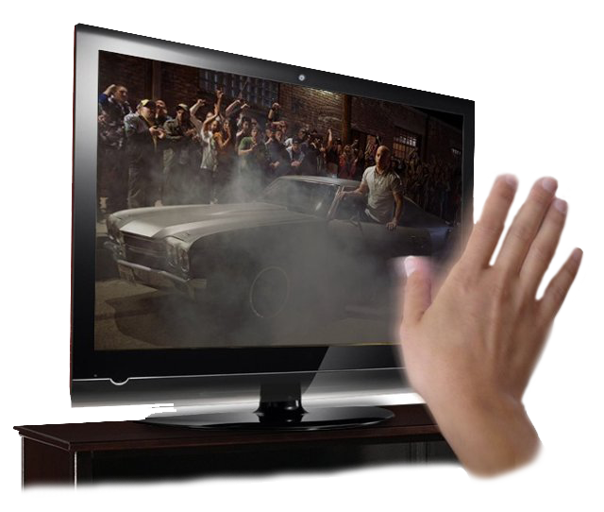
Hand gesture Recognition
Ahmad Abd-Elghany

Slide 2
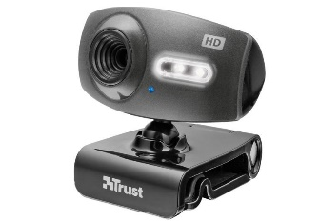
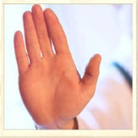
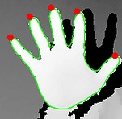
Abstract
we proposed an image processing system using web camera.
Using hand recognition method, we are trying to transfer the gesture to some certain instructions
We mark up the important features of hand: fingertips, hand contours, providing real-time interaction between gesture and the system.

Slide 3
Outline
Introduction
Planning and requirements
System analysis and design
Implementation
Conclusion
Demonstration

Slide 4
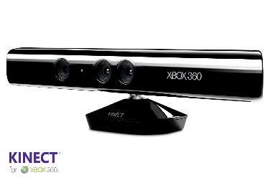
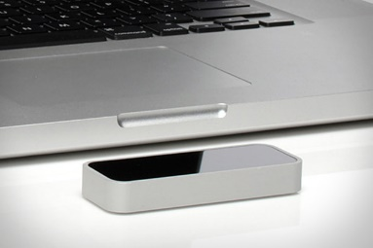
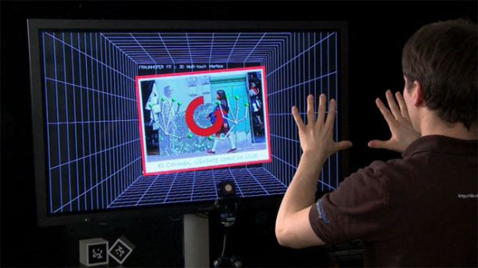
Introduction
Interaction with computers are not comfortable experience.
Too many devices (Keyboard – Mouse – joystick – cameras)
The traditional input devices like keyboard and mouse are being replaced by many devices like:
Microsoft Kinect
Leap motion
Gesture recognition devices and sensors
The hand gesture will be the most popular one.

Slide 5

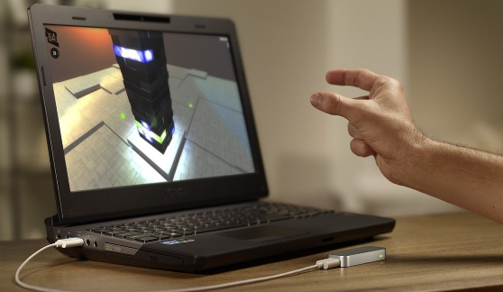
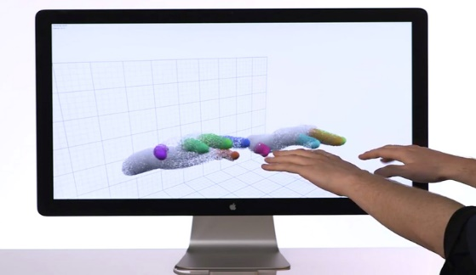
Introduction
With the communication by hand, people will no longer need to use computer devices in a certain location.
The gap between human and machines will be closer.
More and more related products will appear and the gesture Interface will be more important.

Slide 6
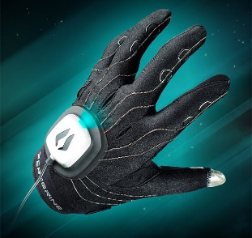
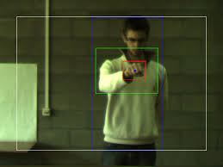
Introduction
Two common technologies for hand gesture recognition
Glove-based method
Using special glove-based device to extract hand position
Annoying
Vision-based method
Skin color Detection and Hand tracking
Most used

Slide 7
Planning and Requirements
Typical vision system
Get the RGB image from the camera
Image pre-processing
Segmentation
Feature extraction
Classification

Slide 8
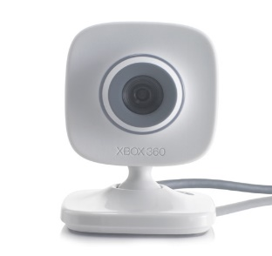
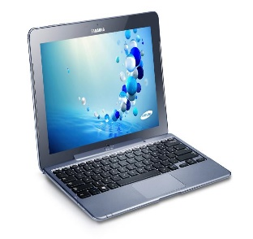
Planning and Requirements
Application requirements vary drastically by industry, but a number of components are common to every machine vision system.
Camera
PC
Software

Slide 9
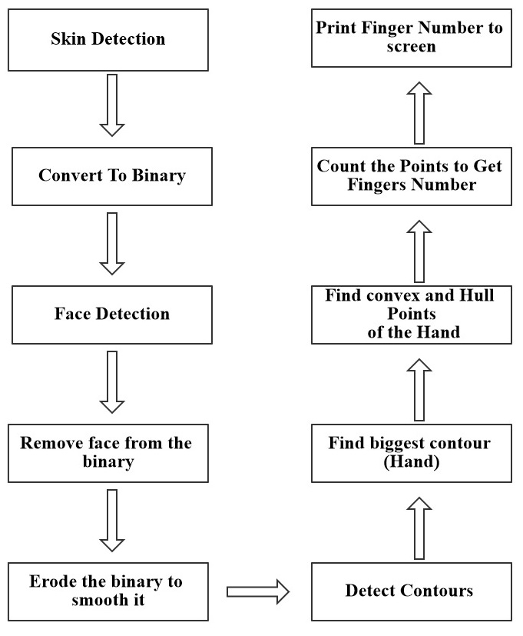
System analysis and design
The original input data will be the RGB image captured by a web camera.
The system and its computation are based on the contour of hand.
We perform some preliminary processing to generate a binary image which provides enough information of hand contour.

Slide 10
System analysis and design
Detecting the face and removing it to detect the highest contour accurately which will be the hand.
The next step is to blur the edges to get a perfect binary image.
We find hull and convex points of the hand.
These points help us counting the finger.
Finger number will be displayed and help sending instructions to computer.

Slide 11
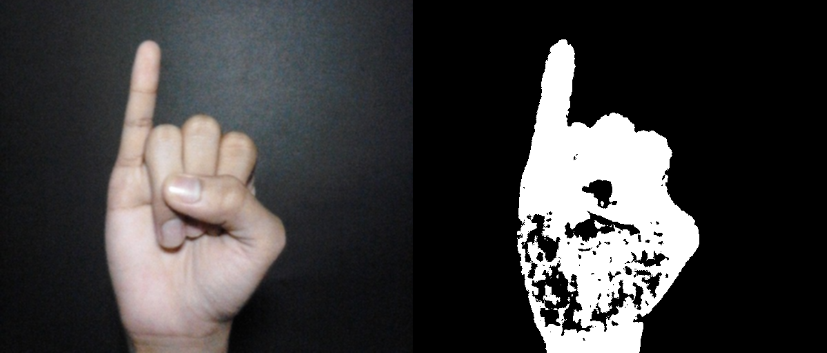
Implementation
Detect skin region from the rest of the image by using color.
RGB is not suitable for color analysis and color based recognition due to mixing of chrominance and luminance data.
HSV and YCbCr color spaces have the luminance and chromaticity information. Hence, they are more suitable for this task.
Get a binary image from the original

Slide 12
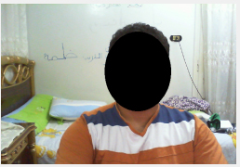
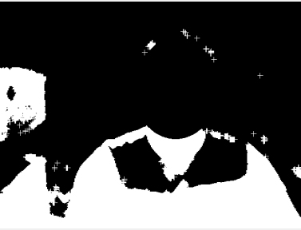
Implementation
Detecting the face using HAAR cascade method
a machine learning based approach where a cascade function is trained from a lot of positive and negative images.
Removing the face from the image
Performing Erode and Dilate filters to get smoother edges.

Slide 13
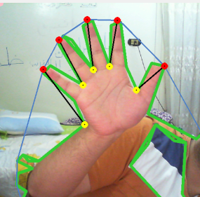
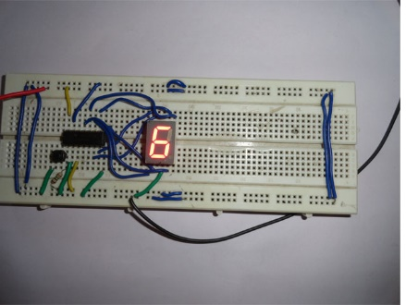
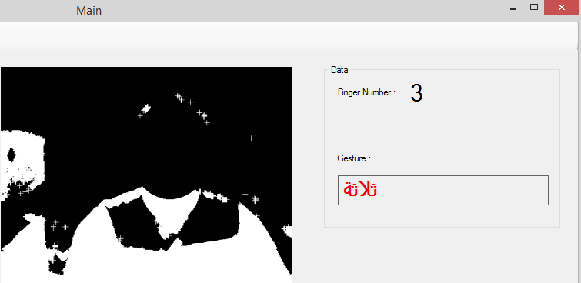
Implementation
Finding biggest Contour moments (Hand).
Using moments you can calculate the area and centroid of an image.
Finding Convex and Hull points of the hand.
Calculating the points help us finding fingers count.
Finishing up by displaying the finger number and message of interest.

Slide 14
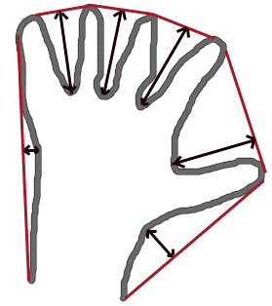
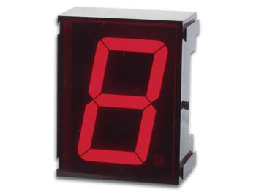
Conclusion
An accurate hand gestures detection system based on hand Convex Hull.
Fast detection process, allows the real time video application with low cost sensors, such as PC and USB camera.
Robust in counting fingers number and extracting them from the image

Slide 15
Demonstration
Start Demo

Slide 16
The end
Thanks

